Slide 1
UVic Course Registration System
Remote Usability Test
Zhanchi Guan, Aaron Yin,
Rui Sun, Junhong Deng

Slide 2
Participants
Socical science(1 st year)
Business (2nd year)
Engineering1 (2nd year)
Psychology (3 rd year)
Engineering2 (4 st year)

Slide 3
Task
Explore and register ATWP
Explore and select ASTR101 and ASTR102 sessions
Drop ASTR102 B01 and register ASTR102 B02

Slide 4
quantitative questions
-How long main tasks take
-How many hints
-How many mistakes

Slide 5
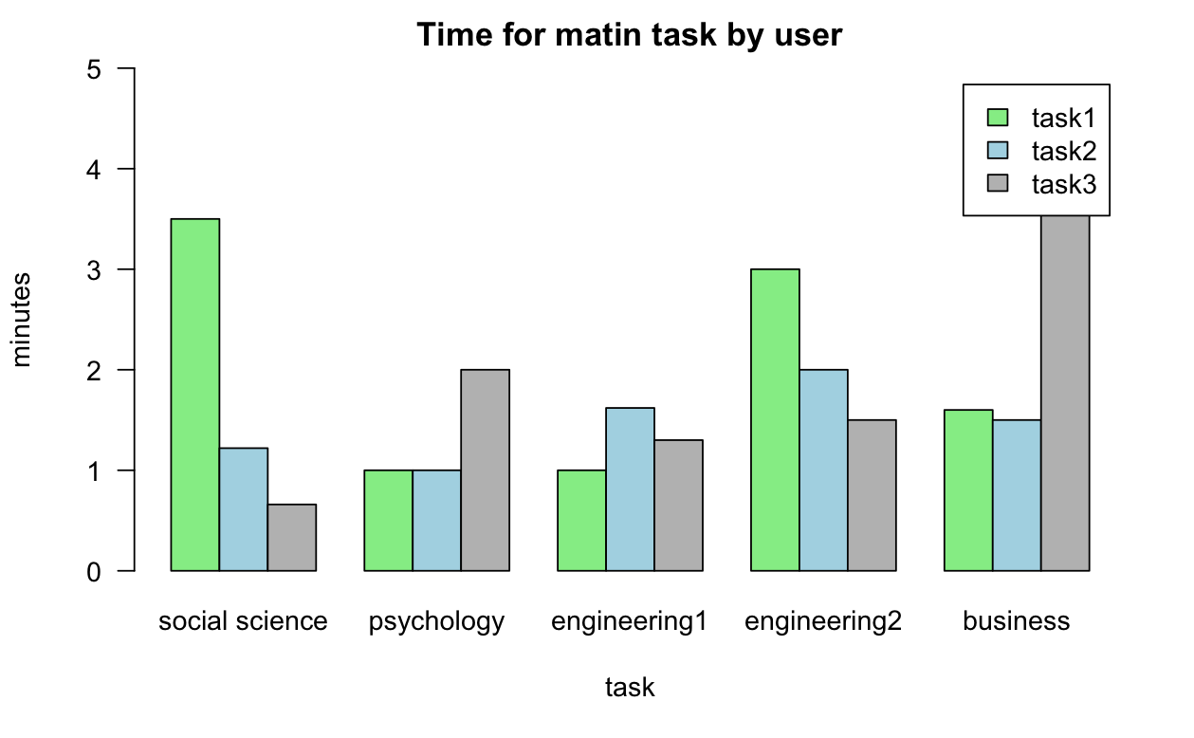
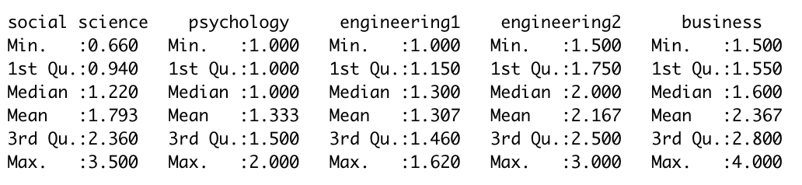
Quantitative
Result

Slide 6
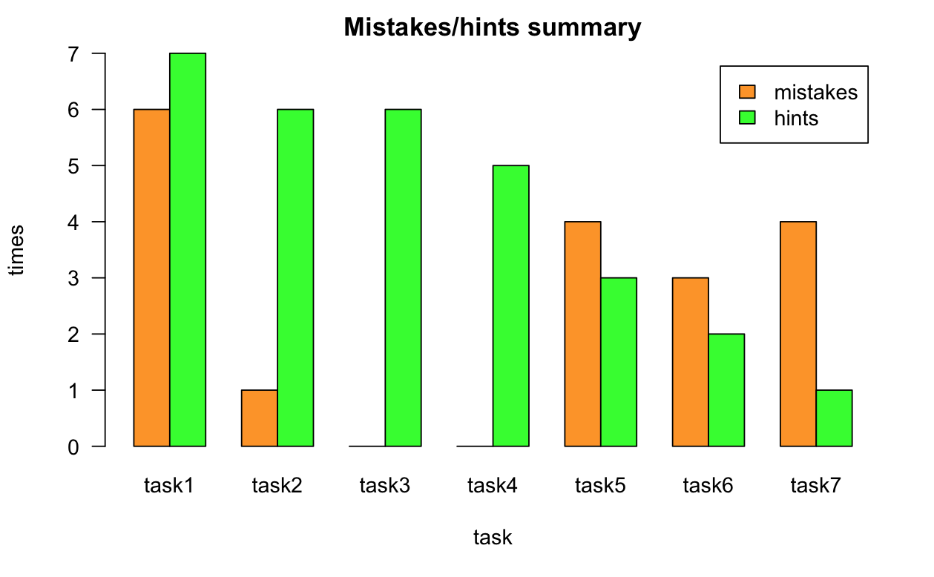
Quantitative
Result

Slide 7
Qualitative Result
Clear navigation
Simple and clear
Convenient

Slide 8
Q & A

Slide 9
Thank You

